Slide 1
Opening a Tea Garden and a Mediterranean Restaurant in San Francisco

Slide 2
Background
The purpose of this project is to find the best area with the potential to open a tea garden mixed with a Mediterranean restaurant (this idea was developed before the coronavirus outbreak, so please ignore the current market conditions for such establishments.)
After acquiring the data for the neighborhood and clustering them by their venues, I will try to find a cluster where the restaurants and food courts are concentrated but do not have many Mediterranean restaurants and tea gardens. If such a cluster does not exist, I hope to find a cluster where the parks are concentrated.

Slide 3
Data Acquisition and Cleaning
The data will be acquired in three steps. These are:
1- Get the neighborhoods in San Francisco from Wikipedia, read and parse the data using beautifulsoup library and turn it into a data frame.
2- Get the latitude and longitude information for these neighborhoods using the geopy library
3- Get the top 10 venues for the neighborhood using the Foursquare API
The above raw data will be turned into valuable information in two steps. These are:
1- After the data is acquired and cleaned using the scikit-learn library to cluster the data.
2- Use the folium library to create a visualization of the San Francisco and its neighborhood clusters.

Slide 4
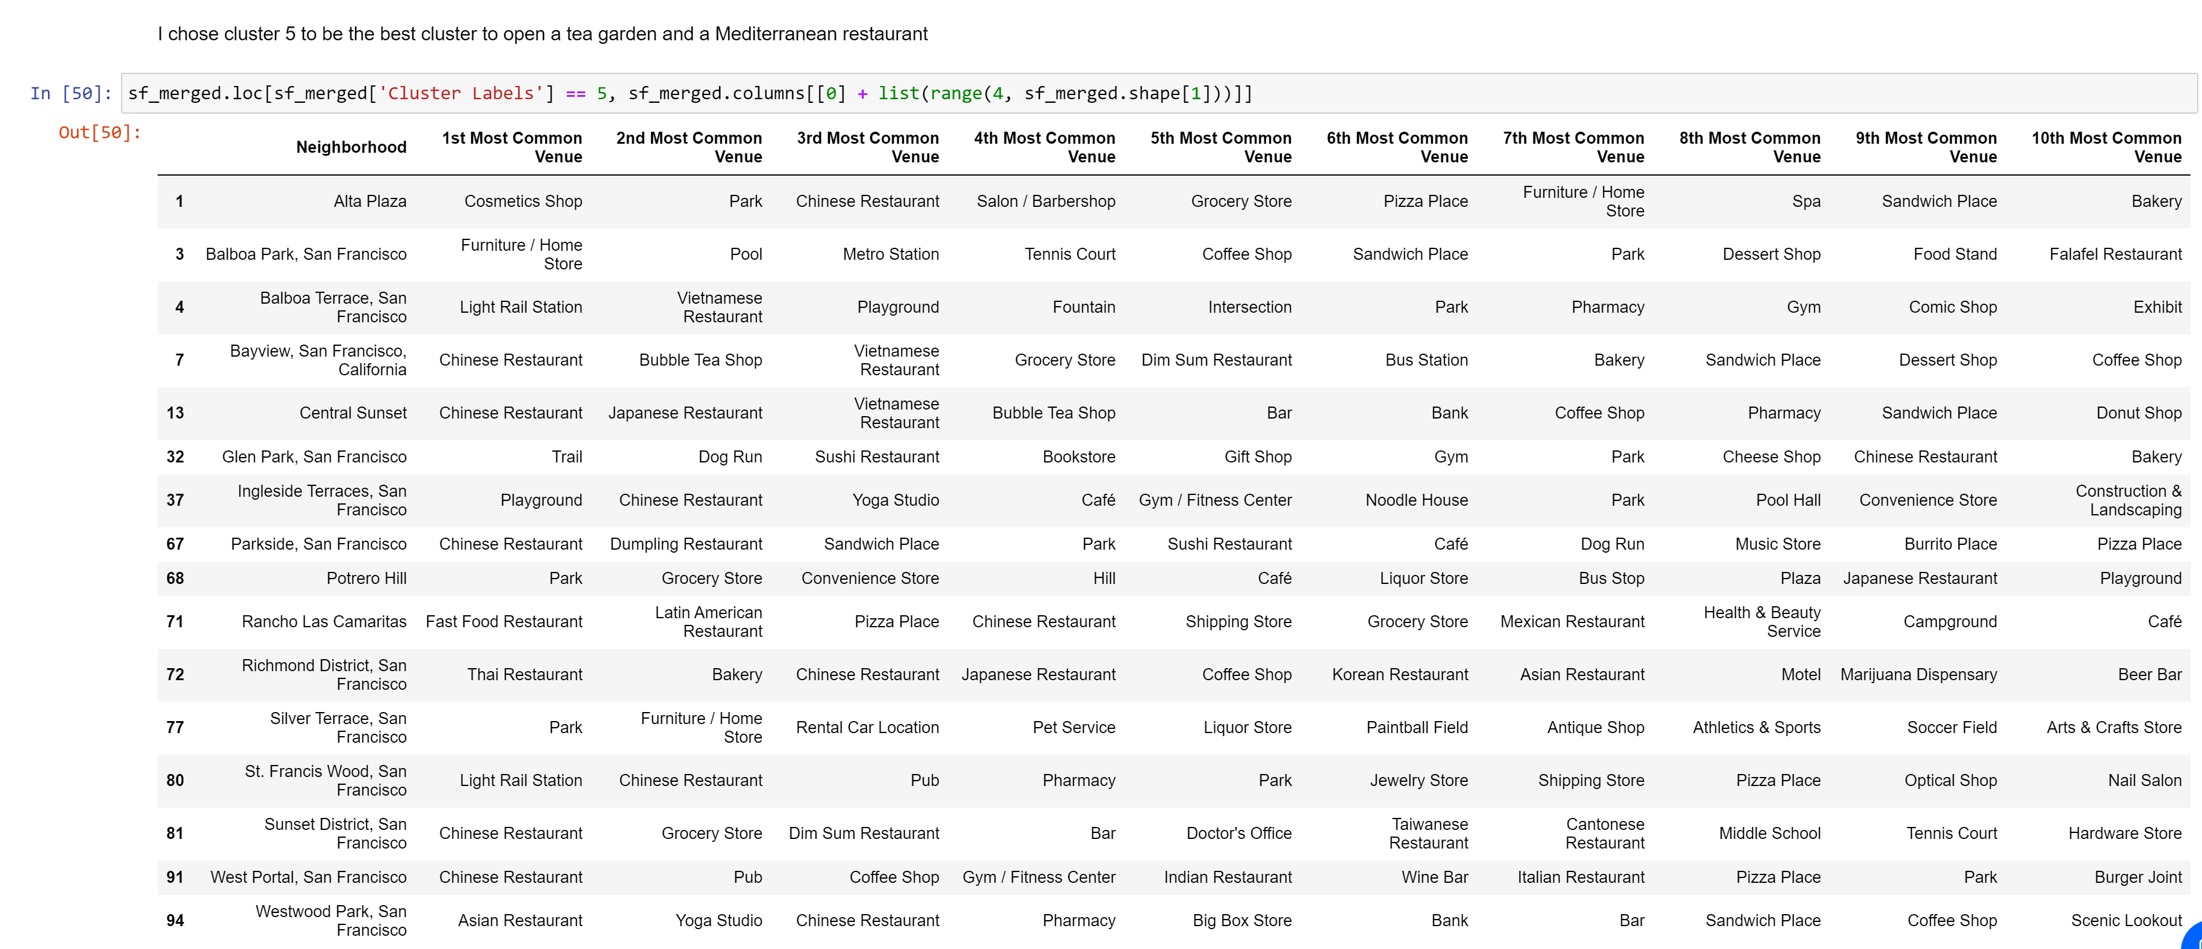
Methodology
From the analysis I have performed I have found 95 neighborhoods in San Francisco. By creating a visual in folium to se the distribution of the neighborhoods I expected to see 8 to 13 clusters. After creating multiple clusters from 5 to 15 I have decided the best number of clusters I can use to be 10.
I have used k-means clustering algorithm because the data I had was best fitted for this particular algorithm. The data is unlabeled, so a clustering algorithm was used. Sci-kit learn library was used because of the simplicity of the project and the library is very easy to use compared to libraries like TensorFlow or PyTorch.

Slide 5
Results
After creating 10 clusters cluster 6 is the best place to open the tea garden and restaurant. This cluster was chosen because of the high concentration of the Asian restaurants. Since tea is an important part of the Asian culture it is believed that the traffic will be higher.
The high concentration of the Asian restaurants also means that the Mediterranean restaurant will be stand-out from its competition. So the customers will be able to enjoy a nice fresh cup of tea that they are used to and have Mediterranean desserts as side that they are not used to. This will provide them a unique experience of tasting nostalgic drink with an unusual dessert.

Slide 6
Discussion
Although 10 clusters were used to be able to create distinct clusters, San Franciscos diverse culture made it nearly impossible to create trully distinct groups. Parkside, San Francisco was chosen to be the optimal location because of the lack of competition in the neighborhood for the tea shops.
One very interesting observation is Forest Knolls, San Francisco. This is such a unique place that even when only two clusters are created the algotrihm clusters everything but the Forest Knolls together, so Forest Knolls is the most unique place in terms of the venues in San Francisco.

Slide 7
Conclusion
In conclusion clusters were created in the San Francisco area to find an optimal location for a Tea Garden and Mediterranean Restaurant. For future improvements more data such as the average price of land, how much land is being sold on the market, what is the traffic flow to the neighborhood and things such as these could be included in the data to make a more clear clustering to analyze where a restaurant should be opened.
Thank you very much for your time!

